Slide 1

WEEK 1 CHALLENGE PROJECT
By Neil, JuWon, Akshaya, Alex, and Sam

Slide 2
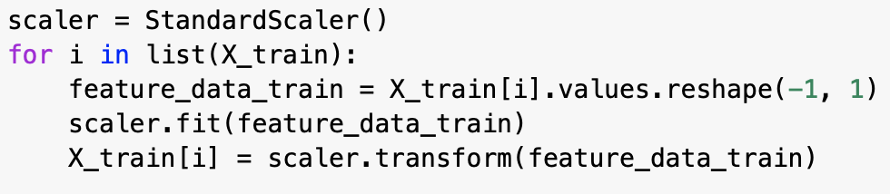
Data Cleaning:
Replaced missing numeric values with medians
Did not want to delete too many people
Then removed rows with Nan values
Converted any outliers in the data to medians
Normalized data using StandardScaler() for all except random forest
Notes:
NEIL

Slide 3
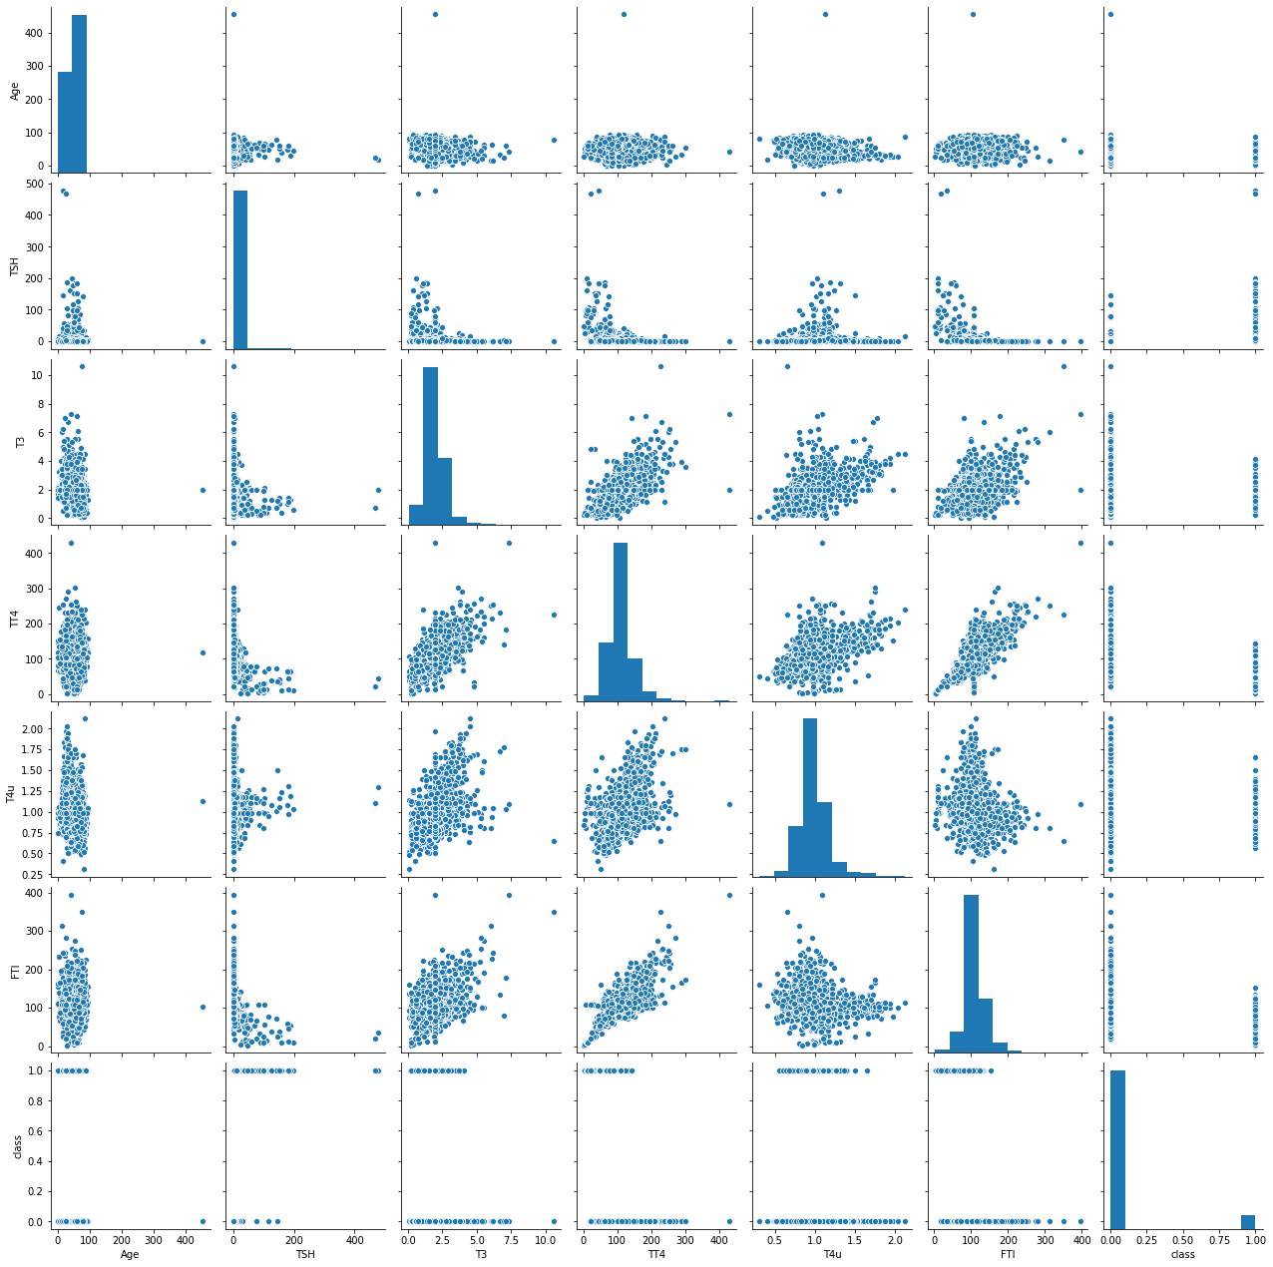

Pairplot of Dataset Before Cleaning
Outliers!
Notes:
NEIL

Slide 4
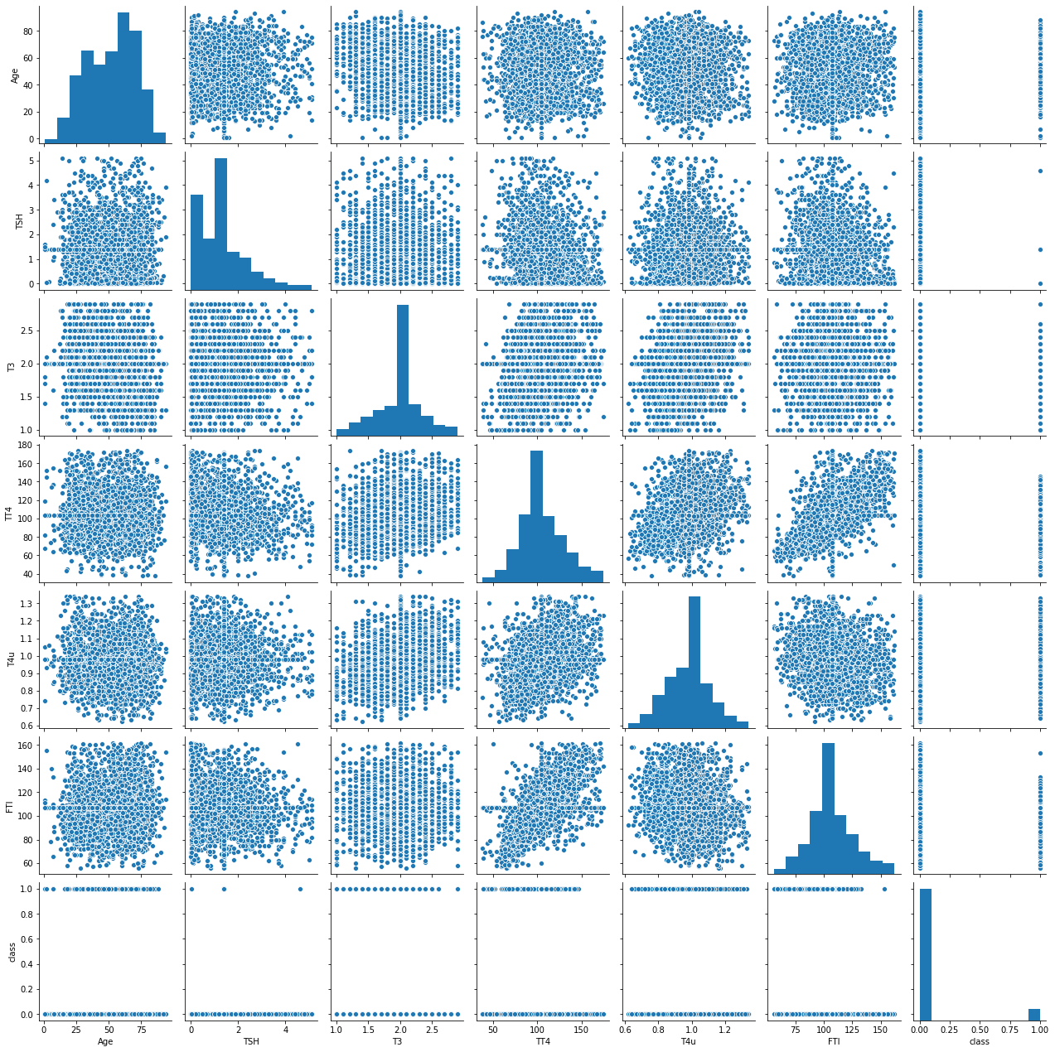
Pairplot of Dataset After Cleaning
*Note that because the outliers were removed, we can more clearly see all of the data*
Notes:
NEIL

Slide 5
Choosing Features
Used correlations and heatmaps to find multiple useful features
FTI, 'TT4', 'TSH', ‘on thyroxine’ generally worked well
Finally decided on ‘TSH’ and ‘TT4’ after trial and error
Notes:
ALEX:
After cleaning the data we chose features based off of the correlations and heatmaps. We will display some images of the correlations on the next slide, but essentially we used the correlations to get an overall idea on what features were best correlated with having hypothyroidism. In the end, FTI, TT4, TSH, and on thyroxine all showed fairly strong correlations. Thus, after running several possible combinations of these features we finally landed on TSH and TT4 because they produced the the highest accuracies, and highest AUC values for the random forest model.

Slide 6
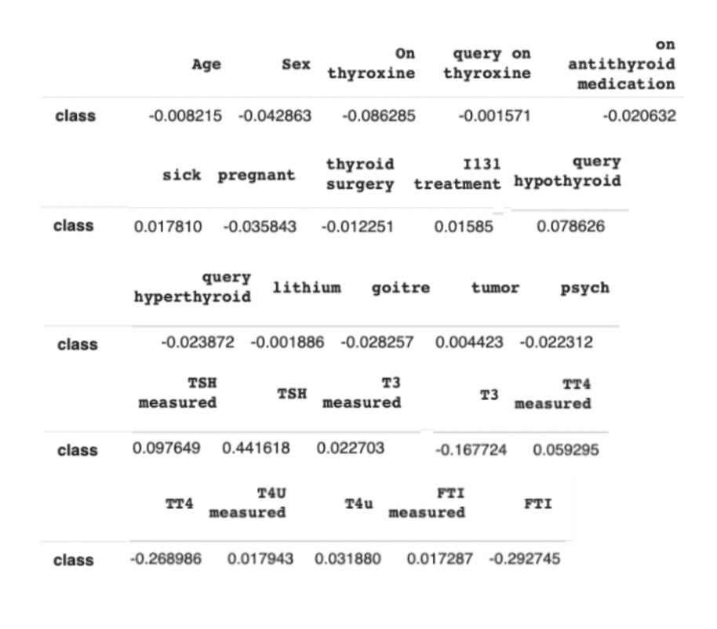
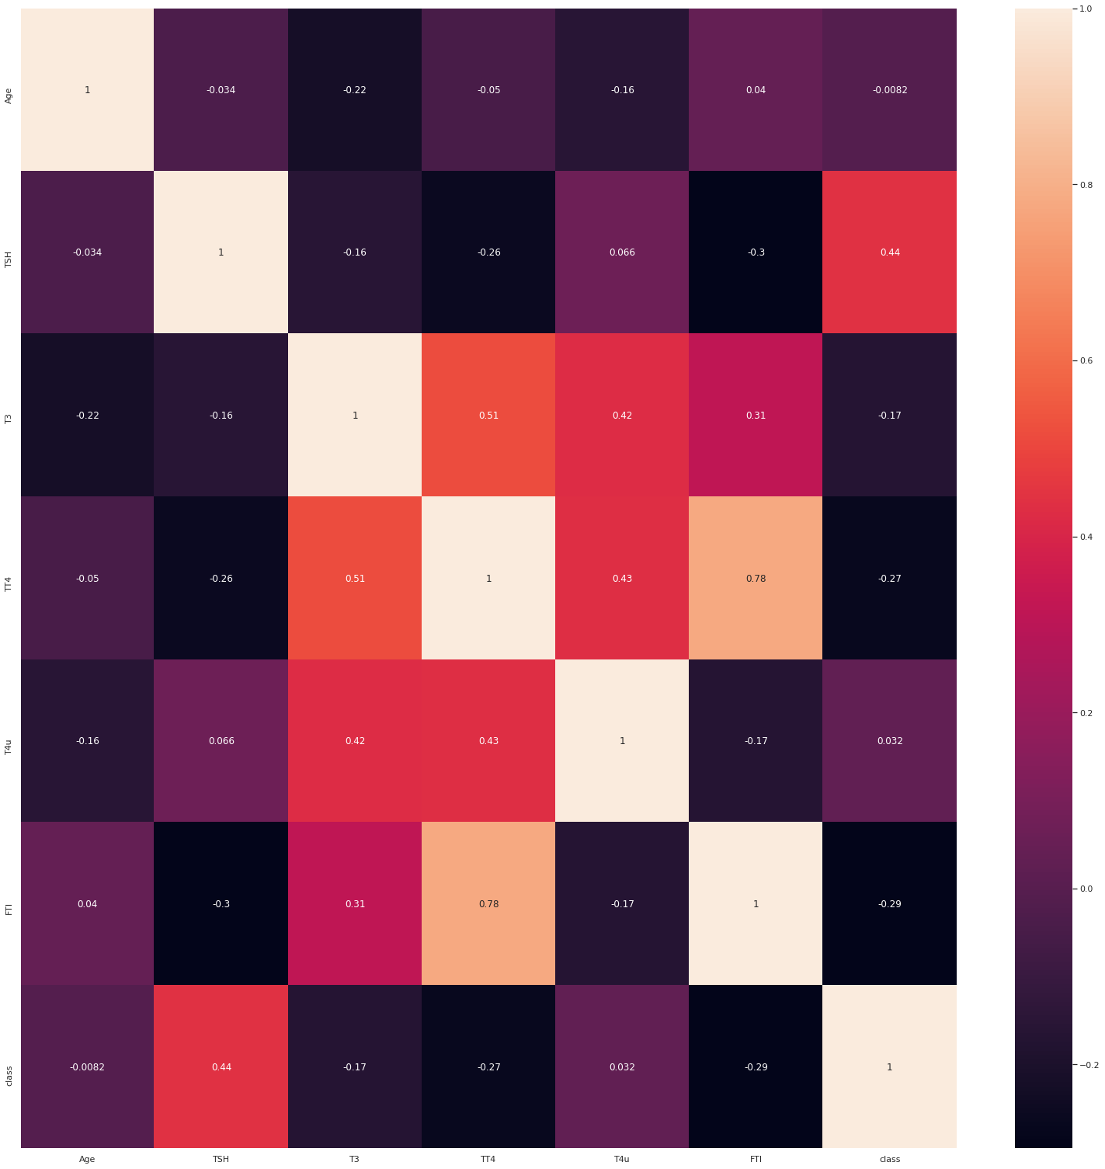
Correlation and Heatmap:
Notes:
ALEX:
So here you can see the correlation and heatmap values. We have highlighted some of the features that have the highest correlations which are...

Slide 7
Splitting training-validation
test_size = 0.2
#split X and y of data into training and test sets
X_train, X_test, y_train, y_test = train_test_split(dataset[X_cols], dataset[y_col], test_size=test_size, random_state=7)
# further split X and y of training into training and validation sets
X_train, X_val, y_train, y_val = train_test_split(X_train, y_train, test_size=0.2, random_state=7)
Split data into two groups: 80% training and 20% testing, then further split the training data as 80% training and 20% validation
Notes:
AKSHAYA
-We split the data set into 80% training and 20%, test data, and of the training data, we split 20% as our validation data set to avoid overfitting.

Slide 8
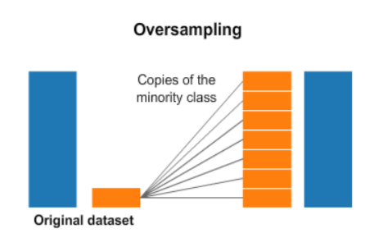
Oversampling!
from sklearn.utils import resample
#combine them train data back for resampling
train_data = pd.concat([X_train, y_train], axis=1)
# separate minority and majority classes
negative = train_data[train_data['class']==0]
positive = train_data[train_data['class']==1]
# upsample minority
pos_upsampled = resample(positive,
replace=True, # sample with replacement
n_samples=len(negative), # match number in majority class
random_state=27) # reproducible results
# combine majority and upsampled minority
upsampled = pd.concat([negative, pos_upsampled])
# check new class counts
upsampled['class'].value_counts()
#New x_train and Y_train
y_train = upsampled['class']
X_train = upsampled.drop('class', axis = 1)
Oversampled our data to reduce skew using .resample()
Added random duplicates from the minority class to balance skewed dataset (1721 → 3160)
Notes:
AKSHAYA
We found in our training data set there were way way more 0s than 1s in our class columns as the zero_rule algorithm spit out a all 0 predicted list, which gave a 90% accuracy, so we had low true positive rate in our classification models, so we conducted oversampling, which created a new training data set with as many 1s as the zeros.

Slide 9
FINAL BINARY MODEL!!!
Notes:
JuWon

Slide 10
Random Forest Model
(Binary classification)
Parameters are Bolded
#random forest classifier
random_forest = RandomForestClassifier(n_estimators = 100, max_depth=5, min_samples_leaf=20, random_state = 7)
# training/fitting the model with training data
random_forest.fit(X_train, y_train)
#predicing class label
y_train_pred=random_forest.predict(X_train)
y_val_pred=random_forest.predict(X_val)
# Predict class label probabilities
y_val_prob = random_forest.predict_proba(X_val)
Parameters: n_estimators, max_depth, min_samples_leaf, random_state
Used trial and error to narrow down the best values to maximize AUROC and True Positives
Features: TT4 and TSH
Notes:
JuWon: We decided to use a random forest model after testing linear regression, logistic regression, svm, and nearest neighbors.
After using trial and error to tweak the parameters for number of trees, max depth, and minimum samples per leaf we found that using the features, TT4 and TSH, with the parameters in bold on the right of the slide were the best values that maximized auroc and true positives.

Slide 11
Test Data Evaluation
Notes:
SAM

Slide 12
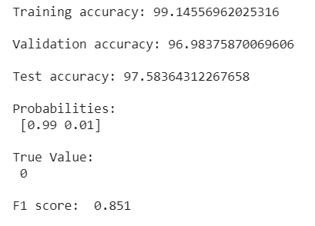
Accuracy
Notes:
SAM
We had a similar training accuracy and validation accuracy, meaning that we can reasonably conclude that our model is not overfit. We can validate our high accuracies with our reasonably high F1 score. A high F1 score generally means that a majority of our true positives are correct predictions.

Slide 13
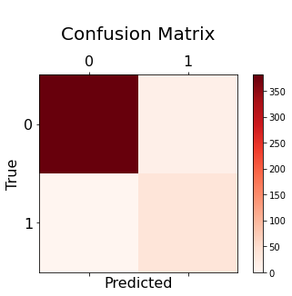
Confusion Matrix
381 | 13
0 | 37
Notes:
SAM
Expanding on the information from the previous slide, we can see that the recall (true pos/ total pos) is 1.0 because all of our positive predictions were true positives and the precision (true neg/total neg) is .74 because a majority of our negative predictions were also true negatives.

Slide 14
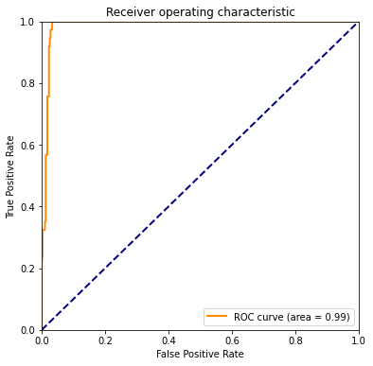
Area Under Curve (AUC)
Notes:
SAM
To clarify, the AUROC is a measure of a model’s capability to separate results into classes. Because of the high AUROC, we can conclude that this model is particularly good at predicting whether or not a patient has hypothyroidism.

Slide 15
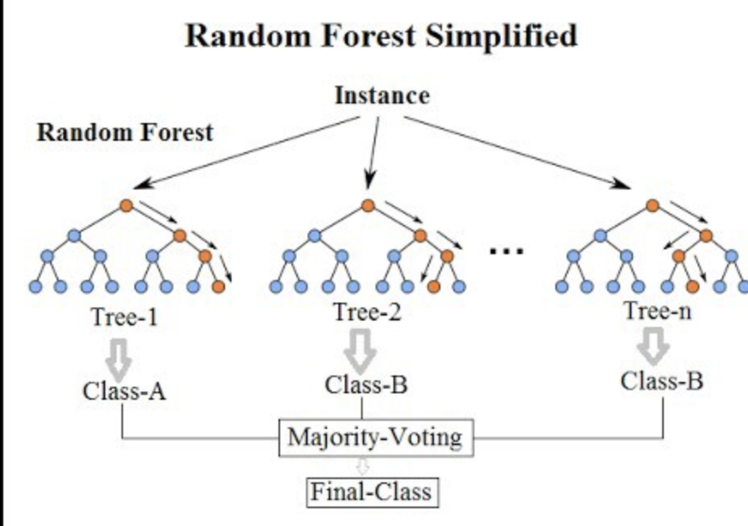
Why Our Model is the Best:
Easy/inexpensive to test for because only 2 features: TSH and TT4
Oversampling balanced the skewed classification data for better training
Able to handle binary, numerical, and categorical features
Avoided overfitting by limiting max_depth and adjust min_sample_leaf
Also tested it on test data to ensure it wasn’t overfit on training
Notes:
SAM
By using the least amount of features possible while still maintaining a high accuracy, our model is both affordable and practical.
Furthermore, the use of oversampling provided us with two major advantages over our other models. The first advantage is that we did not need to sample similar amounts of people who did and did not have hypothyroidism. Besides being hugely impractical, sampling equal amounts of positive and negative patients would be extremely expensive and would require knowledge of whether or not the sampled person has hypothyroidism, which defeats the entire purpose of the study and model.
We were able to adjust our data to be much more balanced, which made training much easier. (reduce skew? With oversampling)

Slide 16
Other Models
Notes:
ALEX

Slide 17
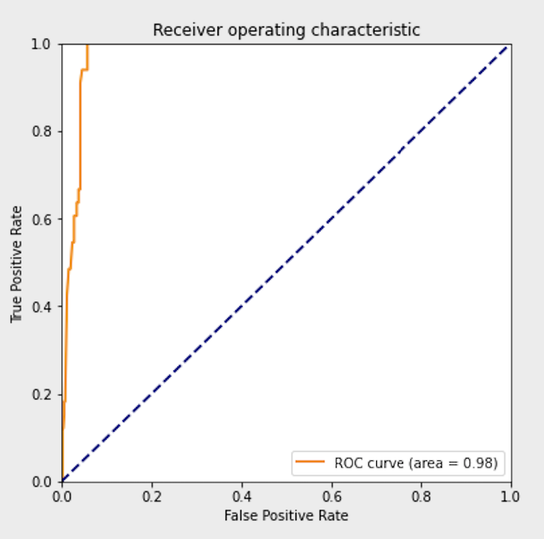
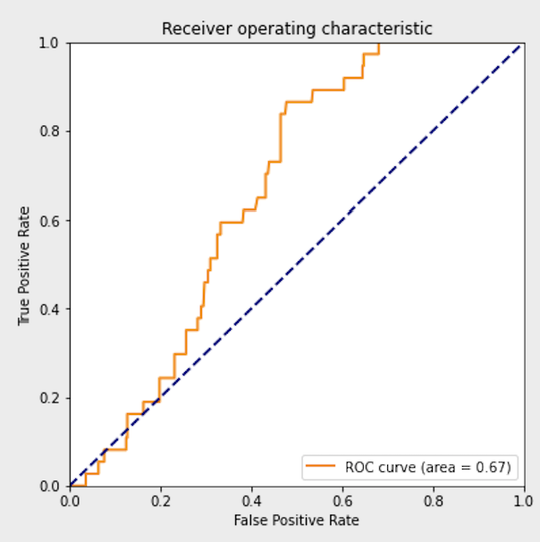
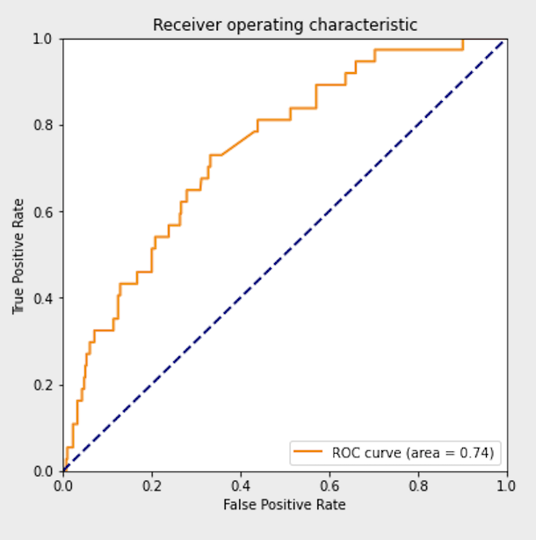
SVM
KNN
Logistic Regression
Used trial and error to determine features:
['TSH', 'TT4', 'TT4 measured', 'TSH measured', 'On thyroxine']
# creating a SVM Model
svm = SVC(gamma=.7, C=1, probability=True)
Used trial and error to determine features:
['TSH', 'TT4', 'TT4 measured', 'TSH measured', 'On thyroxine']
#Creating a Knn model
knn = KNeighborsClassifier(n_neighbors=25)
knn=KNeighborsClassifier(n_neighbors=51)
Used a for loop to determine features:
['T4u', 'TT4', 'TSH']
#creating a Log_Reg Model
model = LogisticRegression()
Notes:
ALEX:
Here are some of the other models that we attempted which include SVM, nearest neighbors, and logistic regression. Based on the three ROC curves, you can see that the best model was SVM. Nevertheless, the ROC curve values are not very high because we quickly realized that the decision tree model was doing very well and stopped testing the other models. We used trial and error to determine the paramaters for each of these models. In order to determine the features for SVM and KNN we looked back at which features showed strong positive or negative correlation with having hypothyroidism, and then tried several combinations of these features, eventually landing on 'TSH', 'TT4', 'TT4 measured', 'TSH measured', 'On thyroxine'. In addition, a for loop was used to test out all possible combinations of the numerial columns, and the features that returned the highest accuracy and ROC curve values were T4u, TT4, and TSH, ephasizing the notion that these features are important for determining whether or not a subject has hypothyroidism.

Slide 18
Random Forest Multi Class classification
Methods:
Ran a for loop of all combinations of features
Final features: TT4, TSH (same as binary classifier)
Same parameters as binary classifier
Learned how to oversample with imblearn, which helped simplify our code for oversampling
Due to time constraints, were not able to calculate ROC curve for our multi-class classification models.
So, we relied on the confusion matrix.
Notes:
JuWon: We stuck with a random forest model since our binary classifier used it also.
We ended up using the same features from the binary classifier for our multi class model after trial and error. Similarly, we learned how to use a tool called imblearn, which simplified
our code for oversampling. Due to time constraints, we only used a confusion matrix to test our multi class model.

Slide 19
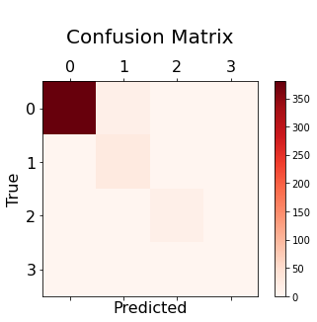
Confusion Matrix
380 | 12 | 1 | 1
0 | 24 | 1 | 0
0 | 0 | 12 | 0
0 | 0 | 0 | 0
Notes:
JuWon: We found that the two features (TT4 and TSH) were able to maximize the diagonal from upper left to lower right to reduce false positives and false negatives for each individual class. So we concluded that we should use these two features.

Slide 20
Thank you for listening!
Any questions?

